Slide 1
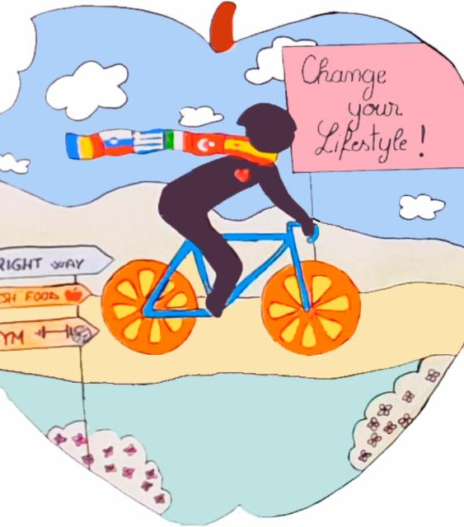
ERASMUS KA2+ 2019-1-RO01-KA229-063230_1 Change your lifestyle! Food for Thought
How the food you eat can affect your brain

Slide 2
Name 3 healthy daily habits.

Slide 3
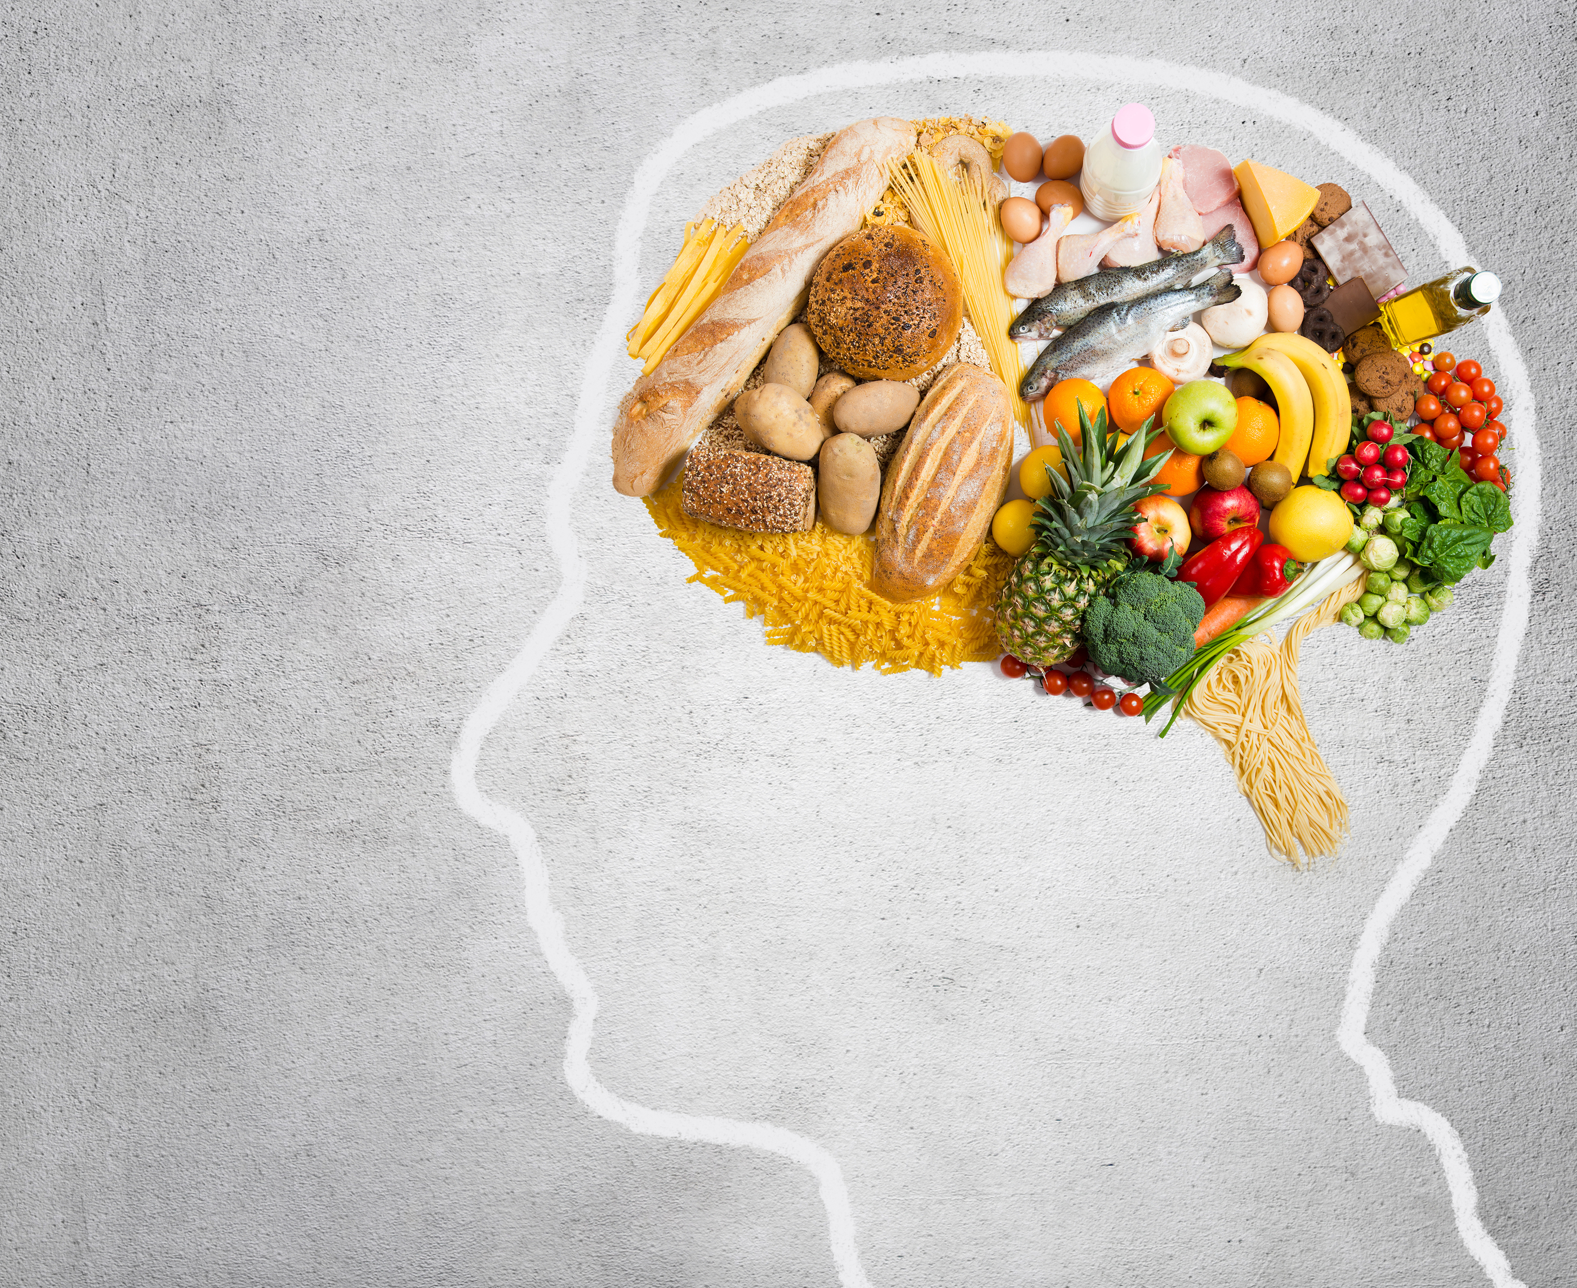
Towards a New Science: Neuronutrition
Neuronutrition is the process of feeding the brain for optimal performance.
(Kelly Aiello, holistic nutrionist)

Slide 4
Eating for cognitive power?
It helps us to:
improve memory;
prevent cognitive decline (avoid Alzheimer disease);
eliminate brain fog;
lift depression.

Slide 5
Brain Food Examples
Wild salmon (wild caught Alaskan salmon) – Omega 3, antioxidants
Avocados – vitamins B, C and K
Coconut oil – great anti-inflammatory
Blueberries – antioxidants, fibres, vitamins C and K
Broccoli – vitamins C, K, fibres, choline
Eggs/quail eggs (free range) – omega 3, choline
Beets – antioxidants, iron
Green leafy vegetables (spinach, kale, lettuce) – vitamins A, K
Extra Virgin Olive Oil – polyphenols
Bone broth – collagen
Black Chocolate - antioxidants

Slide 6
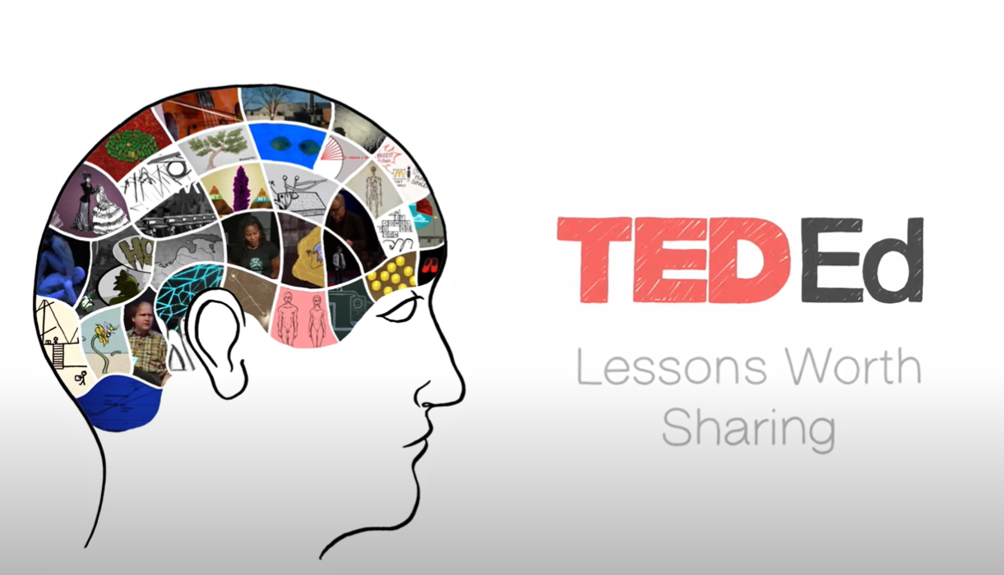
QUIZZ TIME Video: How the food you eat can affect your brain
https://www.youtube.com/watch?v=xyQY8a-ng6g&t=2s

Slide 7
1. Write the food under the correct column. Add your own ideas.
lemons / potatoes / pork / tomatoes / rice / beef / oranges / lettuce
MEAT VEGETABLES FRUIT SIDE DISH

Slide 8
2. Read the words. Fill in the sentences.
proteins / fibre / vitamins / cereals / sugar
Fruit and vegetables have a lot of______________ . SLO
Meat has a lot of______________ . TR
I like a lot of______________ in my coffee. SP
I have _____________ with milk for breakfast. GR
Dark bread is rich in_______________ . RO

Slide 9
5 tips for better brain health 3. What can we do for our brain’s health? Make sentences using SHOULD or SHOULDN’T.
1. We should___________________________________SLO
2. We shouldn’t_________________________________TR
3. We should eat a lot of____________________________________________SP
4. We should eat some_________________________________________GR
5. We should eat small pieces of____________________________________________RO
smoke
black chocolate
spinach
avocados
do sports

Slide 10
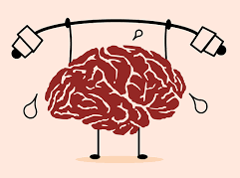
4. Ask and answer in pairs.
What food do you like? What food do you hate? SLO
How many meals a day do you usually have? GR
Where and what time do you usually have breakfast? SP
What’s your typical breakfast? TR
Where and what time do you usually have lunch? RO
Do you do any sports?

Slide 11
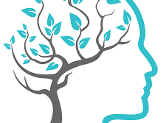
Conclusion
Feed the brain and nourish the mind!
Eat healthy and exercise to keep your brain active!

Slide 13
Thank you!

