Slide 1
OVERWEIGHT
PAST and FUTURE

Slide 2
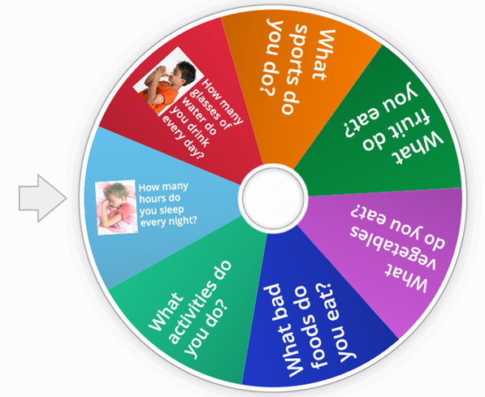
Are you healthy?
Random Wheel
How many hours do you sleep every night?
I usually sleep 8 hours

Slide 3
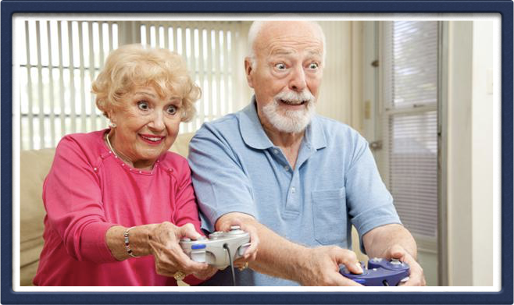
What did your GRAND’S play?
Every country explain the results of the research.

Slide 4
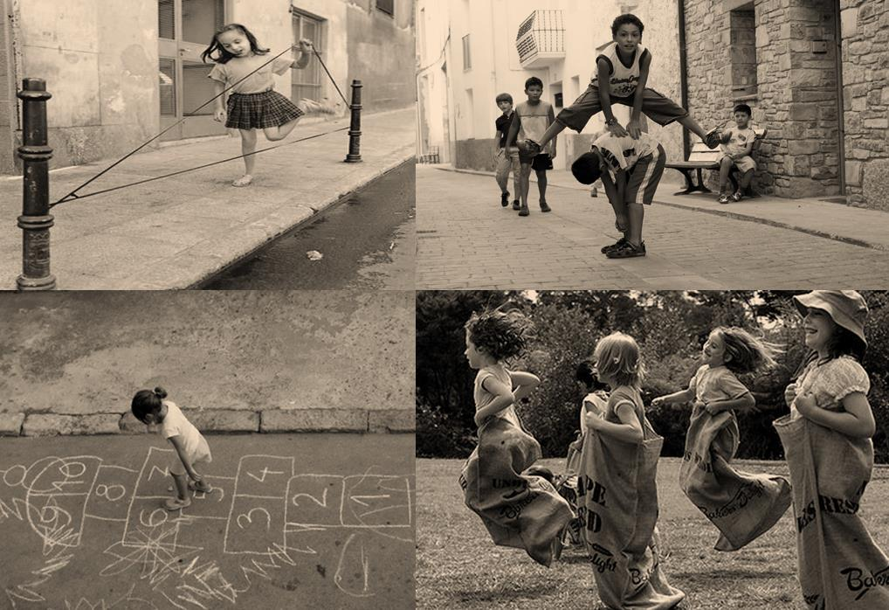
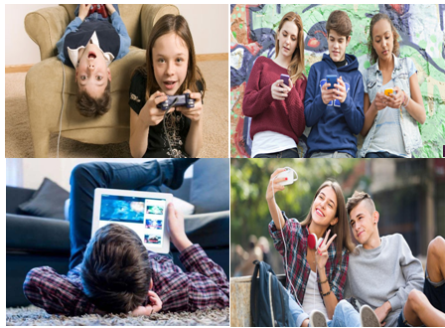
GAMES. Spot the difference
BEFORE
NOW

Slide 5
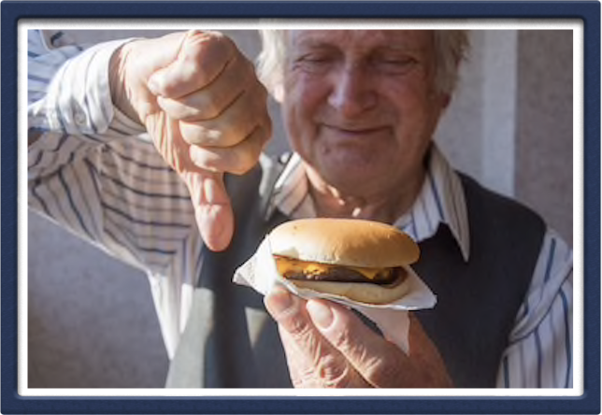
What did your GRAND’S
eat for lunch?
Every country explain the results of the research.

Slide 6
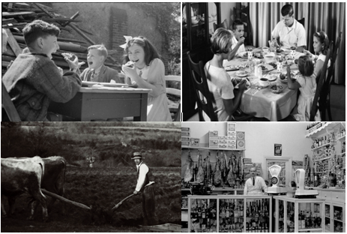
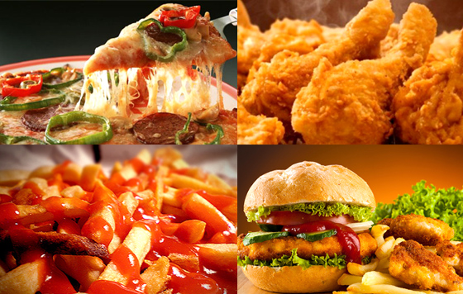
FOOD: Spot the difference
BEFORE
NOW

Slide 7
Do you know the rates
of obesity and overweight in Europe?

Slide 8
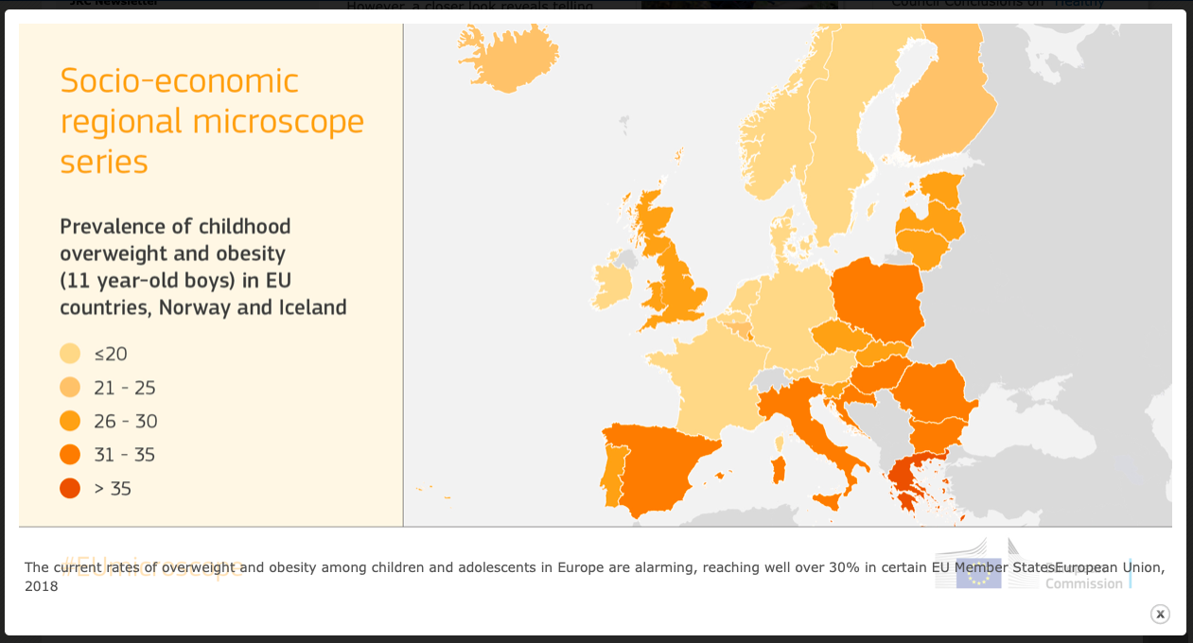

Slide 9
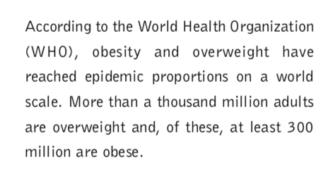
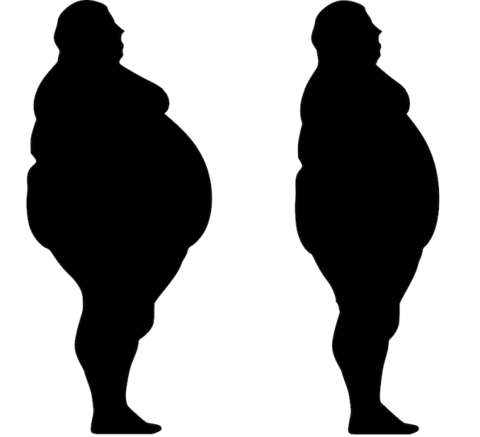
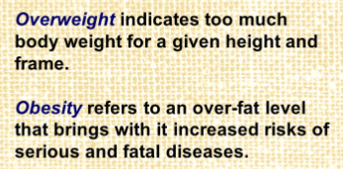
Obesity
Overweight

Slide 10
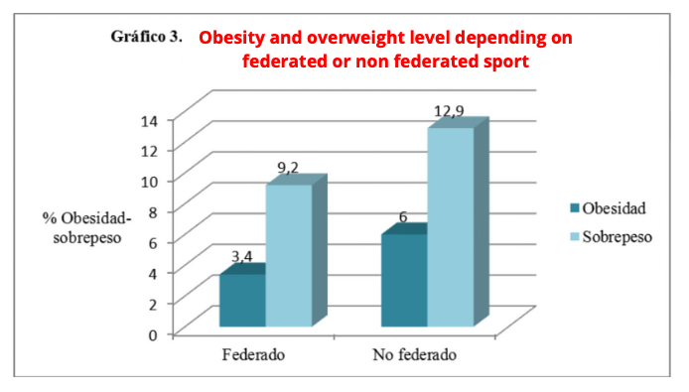
A RECENT RESEARCH
“Adolescence, sedentary lifestyle and overweight: analysis according to variables
socio-personal of the parents and the type of sport practiced by the children”.
UNIVERSITY OF BALEARIC ISLANDS

Slide 11
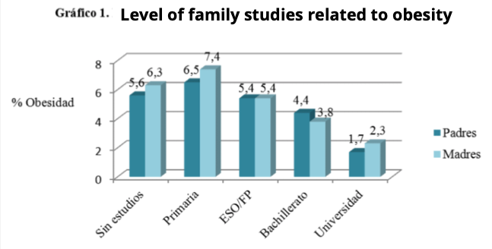

Slide 12
Obesity in last 30 years in Spain
(people under 25)
We can affirm that obesity in last 30 years in Spain has quadrupled

Slide 13
https://youtu.be/g3cU-AtWha8

Slide 14
What are the governments and food industry doing????

Slide 15
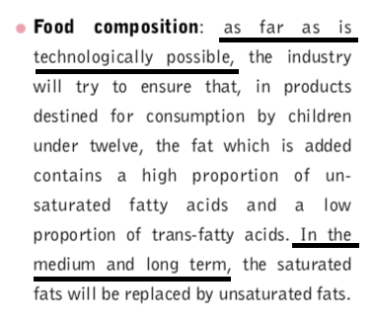
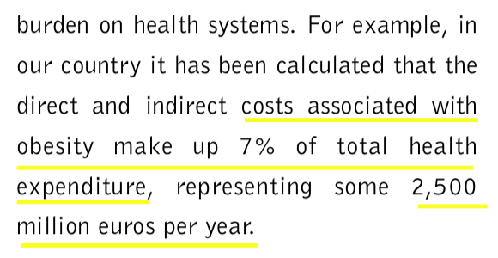

Slide 16
LET’S PLAY
SOME GAMES!!

Slide 17
Let’s see how much you have learnt!
Write in your electronic device→ Play Kahoot - enter game pin

Slide 18
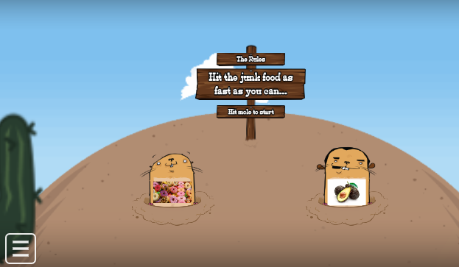
Change your lifestyle just depends on you…
Hit the junk food!!
https://wordwall.net/play/2951/630/408

Slide 19
CONCLUSIONS
What have you learned?

