Slide 1
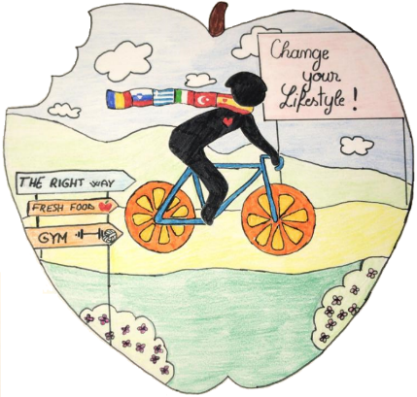
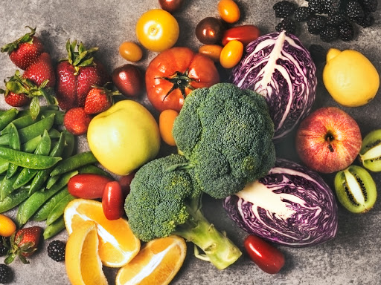
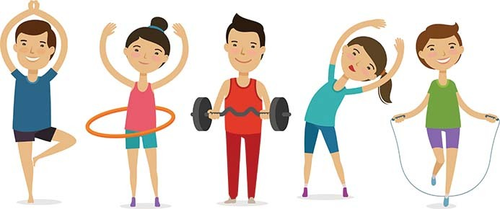
English lesson for Erasmus+
Change Your Lifestyle
U R WHAT U EAT

Slide 2
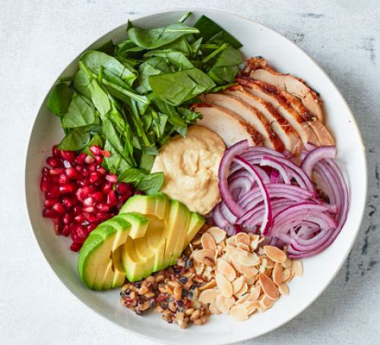
ARE YOU A PICTURE OF HEALTH?
YES, because…
No, because…

Slide 3
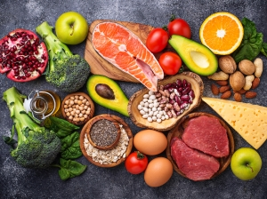
What are the two main principles of healthy life?

Slide 4
WATCH A VIDEO:
https://www.youtube.com/watch?v=0KbA8pFW3tg
First listening: watch the video and state whether the following statements are true (T) or false (F):
The smallest step on the pyramid is about fats and sweets. TUR
Sweets are very good, because they make stress go down. ESP
Proteins consist of meat, fish, eggs, and bread. SLO
We must eat dairy products five times a day. GRE
Fruit and vegetables fill our bodies with vitamins and minerals. ROM

Slide 6
First listening - key
The smallest step on the pyramid is about fats and sweets. TRUE (TUR)
Sweets are very good, because they make stress go down FALSE (ESP)
Proteins consist of meat, fish, eggs, and bread. FALSE (SLO)
We must eat dairy products five times a day. FALSE (GRE)
Fruit and vegetables fill out bodies with vitamins and minerals. TRUE (ROM)

Slide 7
Watch the video once more and answer shortly the following questions:
https://www.youtube.com/watch?v=0KbA8pFW3tg
1.) What do healthy foods help us? ROM
2.) Which step of the pyramid is the worst for our health? ROM
3.) Should we eat more fish and eggs or meat? TUR
4.) How do we call milk, cheese and butter? TUR
5.) Why are fruit and vegetables so important? SLO
6.) Which food is at the base of the pyramid? SLO
7.) Name all the five steps of the pyramid! ESP
8.) What will help you stay strong and healthy? ESP
9.) What must we drink? GRE
10.) What must we do every day besides healthy eating? GRE

Slide 9
Listening exercise: key
1.) What do healthy foods help us? grow, be strong, be healthy (ROM)
2.) Which step of the pyramid is the worst for our health? fats and sweets (ROM)
3.) Should we eat more fish and eggs or meat? fish and eggs (TUR)
4.) How do we call milk, cheese and butter? dairy (TUR)
5.) Why are fruit and vegetables so important? fill our bodies with vitamins and minerals and allow us to stay in shape and be strong (SLO)
6.) Which food is at the base of the pyramid? carbohydrates (SLO)
7.) Name all the five steps of the pyramid! fats and sweets, proteins, dairy, fruit ad vegetables, carbohydrates (ESP)
8.) What will help you stay strong and healthy? eating healthy and doing exercise (ESP)
9.) What must we drink? water (GRE)
10.) What must you do every day besides healthy eating? some physical exercise (GRE)

Slide 10
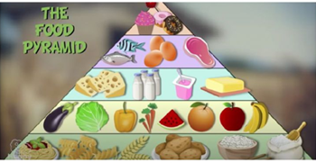

Slide 11
Which foods should you eat more and which less or fewer?
sweets
butter
ice cream
eggs
chocolate
yoghurt
rice
pasta
lettuce
hot dogs
meat
potatoes
fried food
sugar
carrots
hamburgers
chicken
apples
cereals
fish
We should eat MORE:
We should eat LESS/FEWER:

Slide 12
KEY:
We should eat MORE:
butter
eggs
yoghurt
rice
pasta
lettuce
meat
potatoes
carrots
chicken
apples
cereals
fish
We should eat LESS/FEWER:
sweets
ice cream
chocolate
hot dogs
fried food
sugar
hamburgers

Slide 13
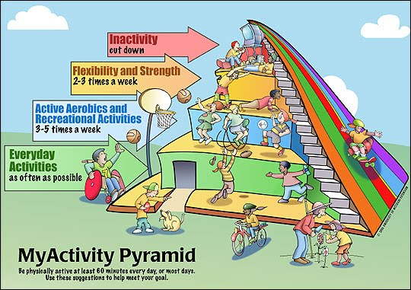
ACTIVITY PYRAMID:
Take a look at the exercise pyramid and answer the following questions!
Which activities are at the top? ESP
Which activities are for flexibility and strength? SLO
Which activities should we practice 3-5 times a week? TUR
Which activities should we do every day? ROM
Which activities are healthy, from the bottom of from the top? GRE
Do you do any physical exercise? How often?
Which is your favourite sports activity?
Which activities should you absolutely avoid?

Slide 14
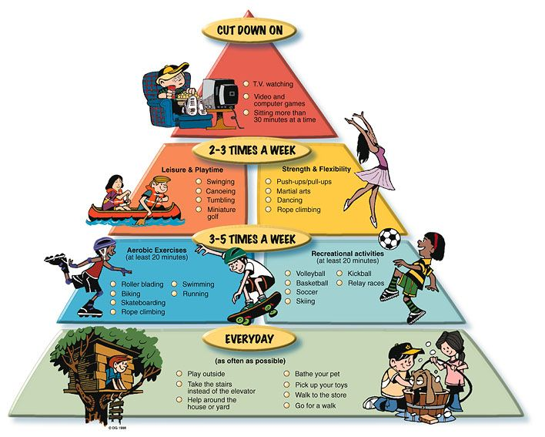
ACTIVITY PYRAMID

Slide 15
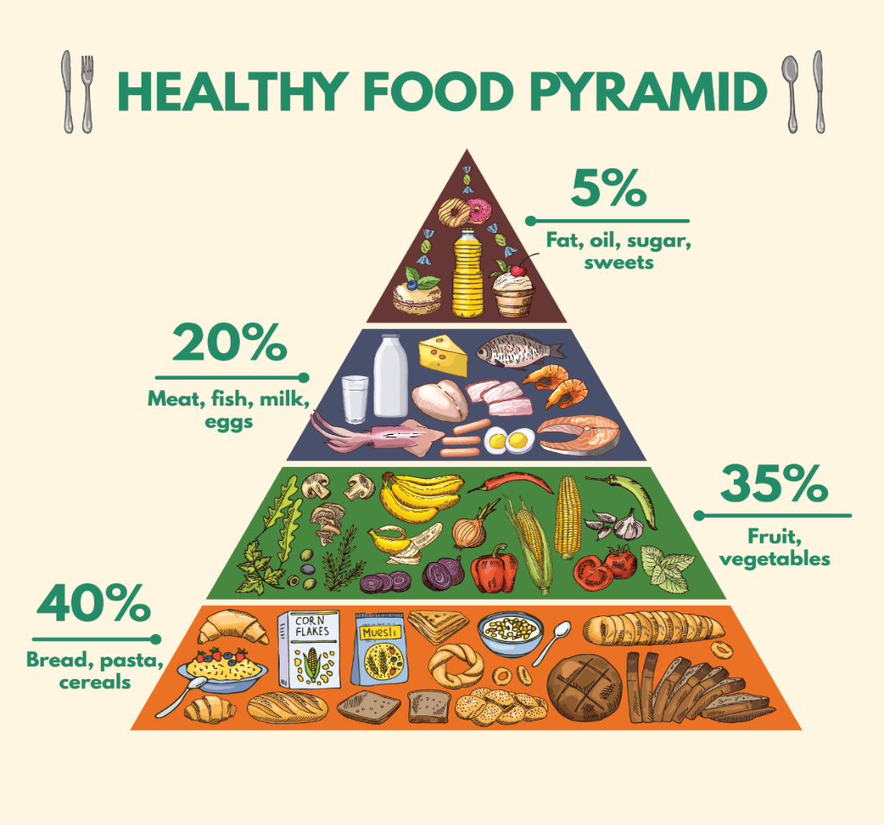
FOOD PYRAMID vs. ACTIVITY PYRAMID
Can you notice any similarities between the two pyramids?
The food and the activities that we should avoid are on the top of the pyramid.
The food that we should eat in moderation is in the centre and so are the activities.
The food that we should eat the most and the activities we should practice the most are at the bottom of the pyramid.

Slide 16
KAHOOT QUIZ
Let‘s have some fun with a Kahoot quiz!
Go to kahoot.it, type a nickname (your first name) and insert the quiz code.
https://create.kahoot.it/kahoots/my-kahoots/folder/cb3ee137-5286-4d0a-9d37-9131fc102331

Slide 17
KAHOOT

Slide 18
Interactive worksheet
You can practice the text you watched and listened to and learn some vocabulary by doing interactive exercises I made for you. You can find the exercises on
https://www.liveworksheets.com/lg733145ov
When you finish doing the exercise, you click on the button FINISH and you can check your answers immediately.

Slide 19
Thank you for your attention!
You are great!

Slide 20
TRANSCRIPTION OF THE LISTENING EXERCISE:
We already know that healthy foods are fundamental for our existance. They help us grow, be strong and be healthy. To eat healthily one must learn about variety and quantities of the food we eat. We need to learn about the food pyramid and follow its steps.
The first step on the pyramid, the smallest one, is the one about fats and sweets. It's the favourite one by all children, but it is the worst one. One must eat very little or nothing from this step. Pastries and sweets are delicious, but they contain a high number of calories which are very bad for our body. In fact, many doctors agree that this sector is very bad for our health.

Slide 21
The second step is formed by proteins. We can find them in meat, fish and eggs. It is very important to eat these foods every single day, but you shouldn't just eat meat because you don't like fish. In fact, we should eat more fish and eggs than meat.
The third step is all about dairy. This group consists of milk, cheese and butter. I especially like yoghurts. We must eat these foods from one to three times a day.
The fourth step is extremely important because it evolves around fruit and vegetables. These foods fill our bodies with vitamins and minerals and allow us to stay in shape and be strong. Doctors recommend to eat five times a day. If you do, your body will thank you.

Slide 22
The base of the pyramid, the fifth step, is the group of the carbohydrates. Here you can find cereals, bread, pasta, rice and potatoes. They are also very important, so we must eat them daily as well as following the different steps in the pyramid. We need to take into account the advice of doctors and nutrition experts.
Eating with family will always be beneficial and also drink plenty of water, but most importantly, every day we must do some kind of physical exercise. If you eat healthy and do exercise,you will grow strong both mentally and physically.

